Slide 2
Data Transfer Instructions
MOV dest, source dest ← source
Stack instructions
PUSH byte ;increment stack pointer, ;move byte on stack
POP byte ;move from stack to byte, ;decrement stack pointer
Exchange instructions
XCH a, byte ;exchange accumulator and byte
XCHD a, byte ;exchange low nibbles of ;accumulator and byte

Slide 3
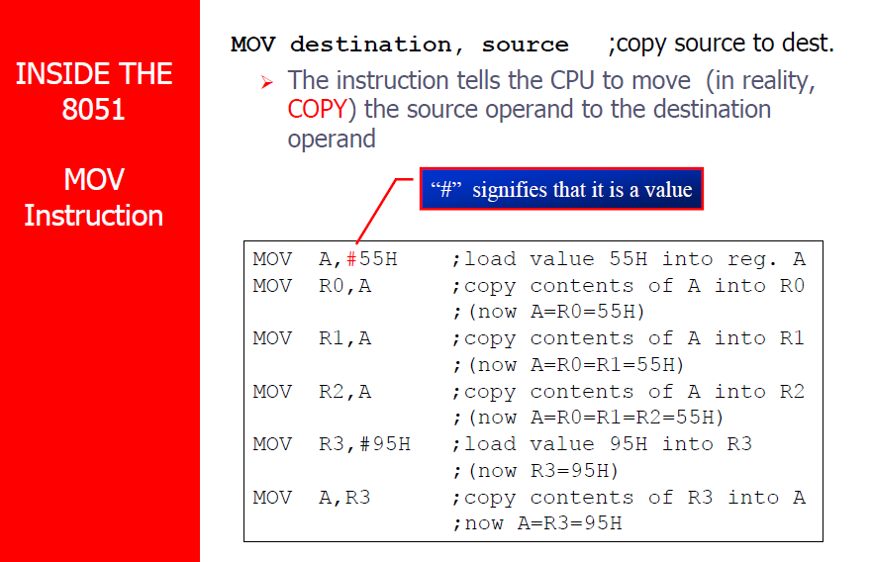

Slide 4
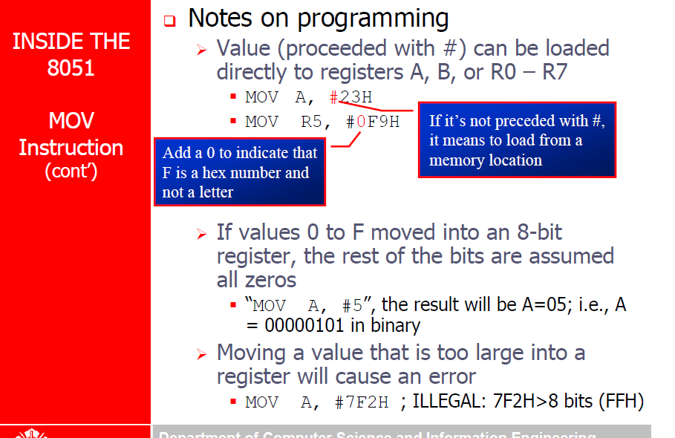

Slide 5
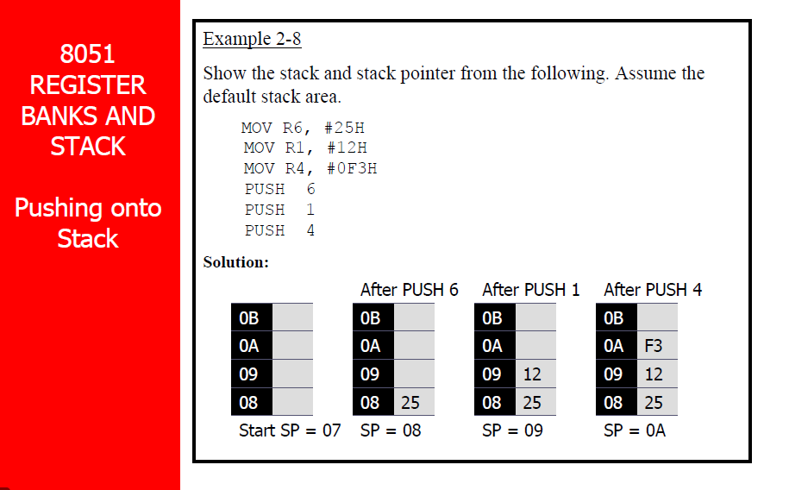

Slide 6
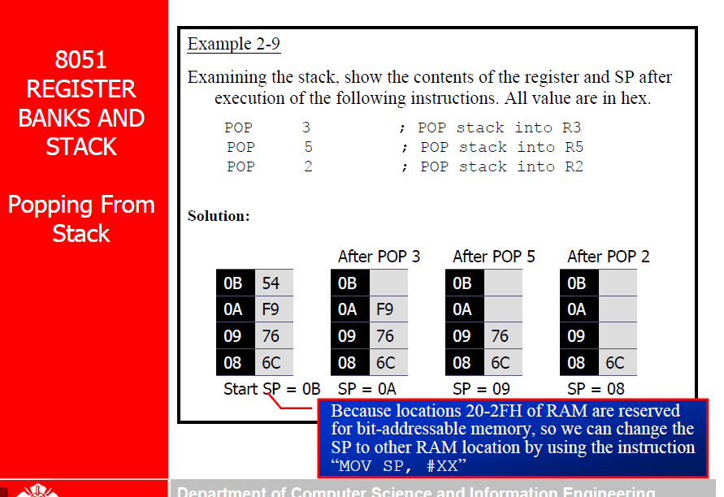

Slide 7
Exchange Instructions
two way data transfer
XCH a, 30h ; a ←→ M[30]
XCH a, R0 ; a ←→ R0
XCH a, @R0 ; a ←→ M[R0]
XCHD a, R0 ; exchange “digit”
a[7..4] a[3..0]
R0[7..4] R0[3..0]
Only 4 bits exchanged

Slide 8
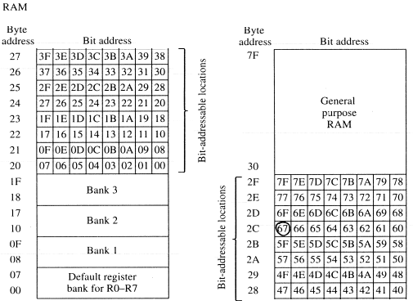
Bit-Oriented Data Transfer
transfers between individual bits.
Carry flag (C) (bit 7 in the PSW) is used as a single-bit accumulator
RAM bits in addresses 20-2F are bit addressable
mov C, P0.0
mov C, 67h
mov C, 2ch.7

Slide 9
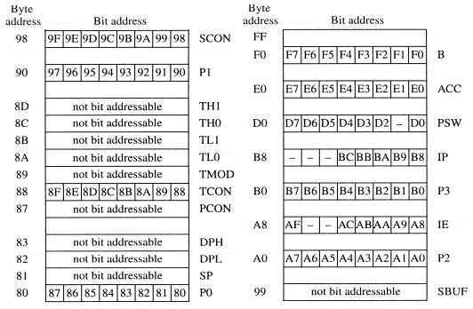
SFRs that are Bit Addressable
SFRs with addresses ending in 0 or 8 are bit-addressable.
(80, 88, 90, 98, etc)
Notice that all 4 parallel I/O ports are bit addressable.

Slide 10
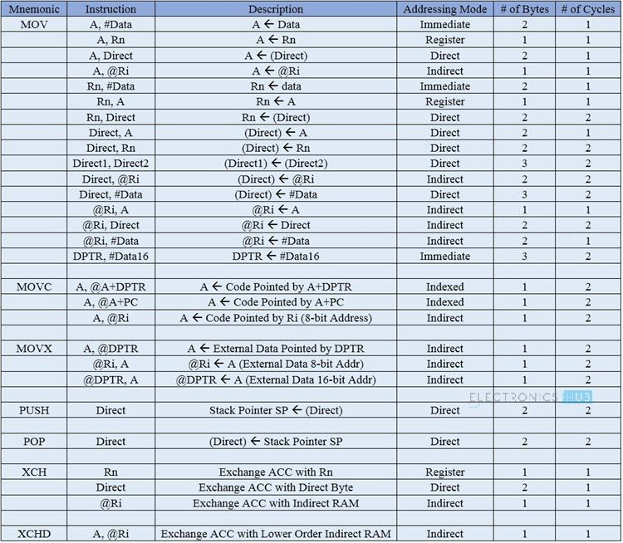

Slide 11
Arithmetic instructions

Slide 12
Arithmetic Instructions
Mnemonic | Description
ADD A, byte | add A to byte, put result in A
ADDC A, byte | add with carry
SUBB A, byte | subtract with borrow
INC A | increment A
INC byte | increment byte in memory
INC DPTR | increment data pointer
DEC A | decrement accumulator
DEC byte | decrement byte
MUL AB | multiply accumulator by b register
DIV AB | divide accumulator by b register
DA A | decimal adjust the accumulator

Slide 13
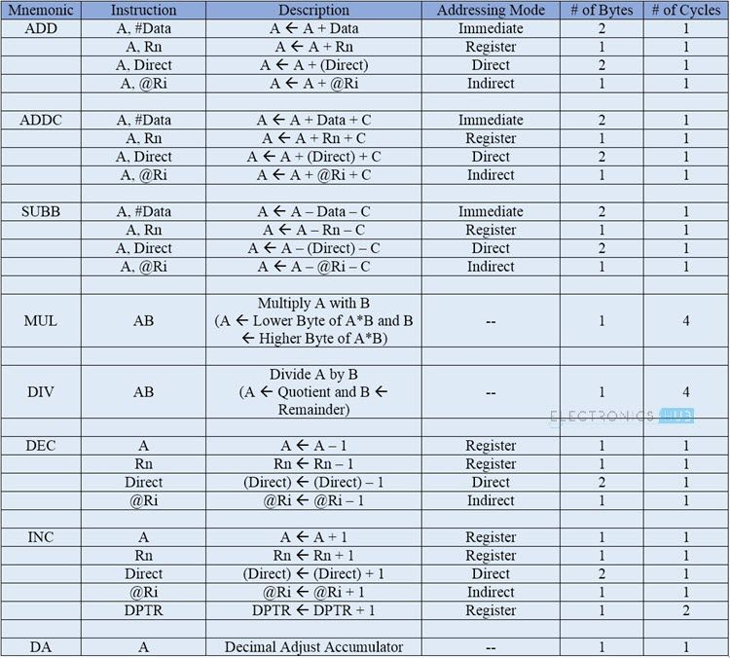

Slide 14
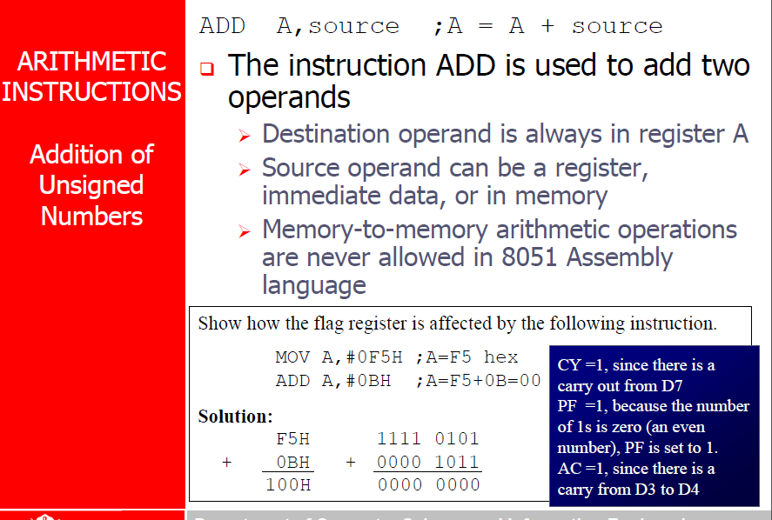

Slide 15
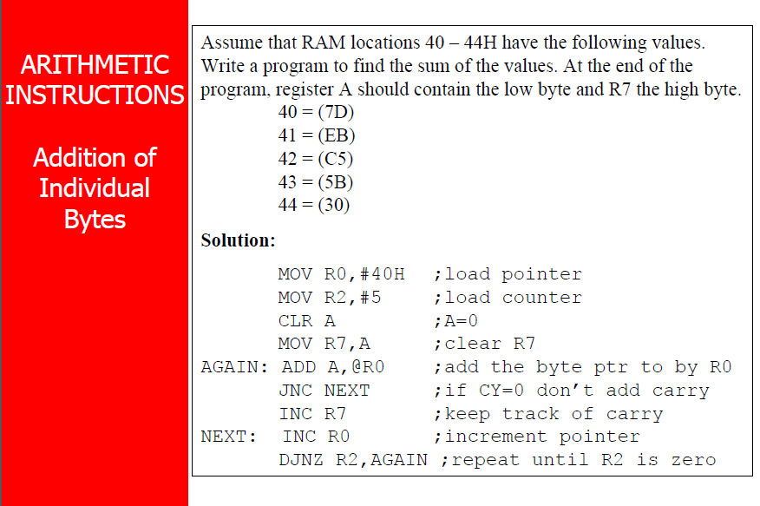

Slide 16
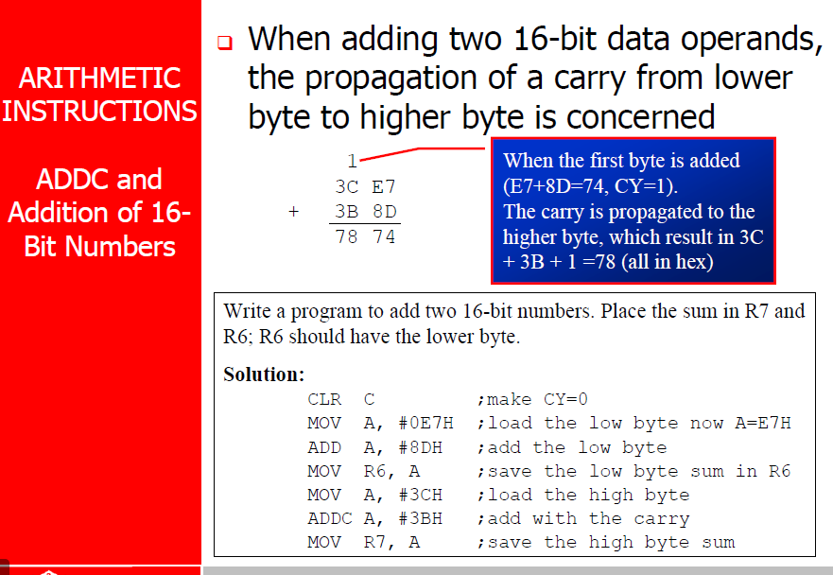

Slide 17
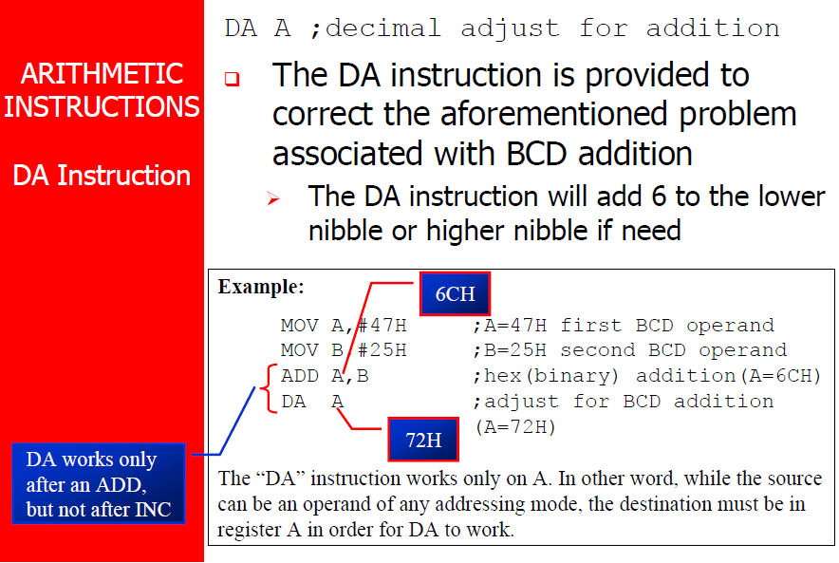

Slide 18
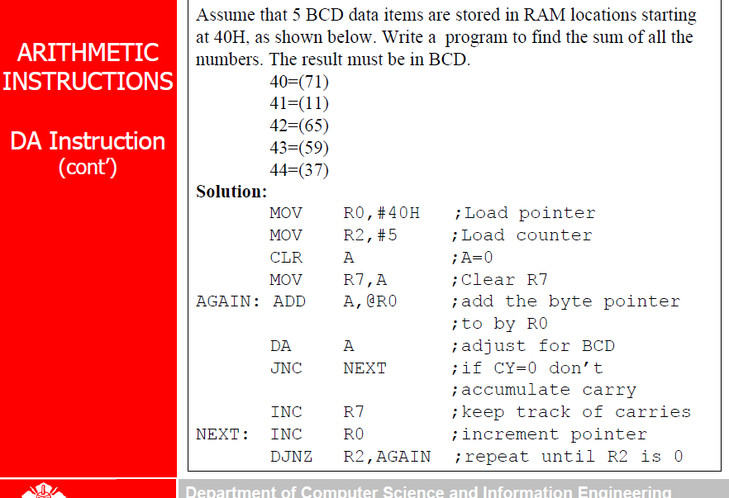

Slide 19
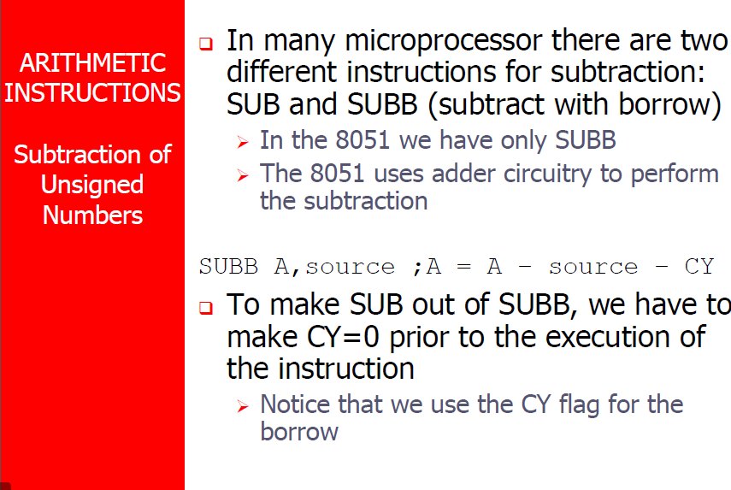

Slide 20
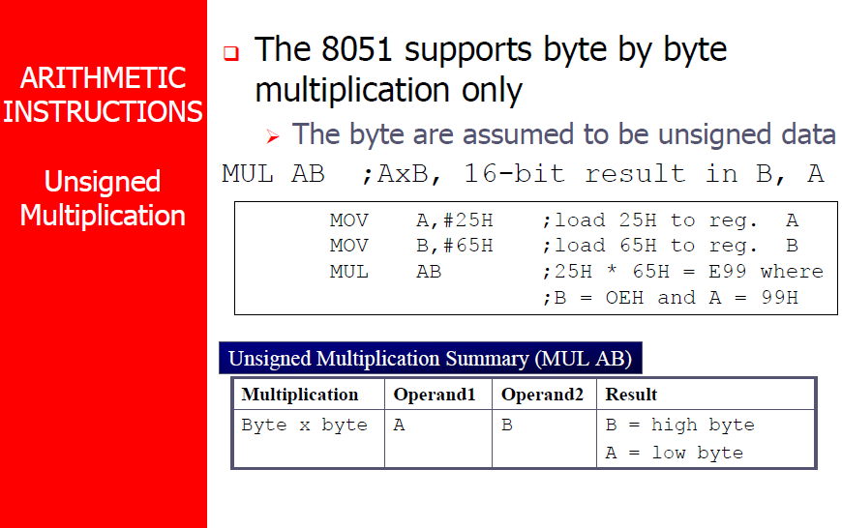

Slide 21
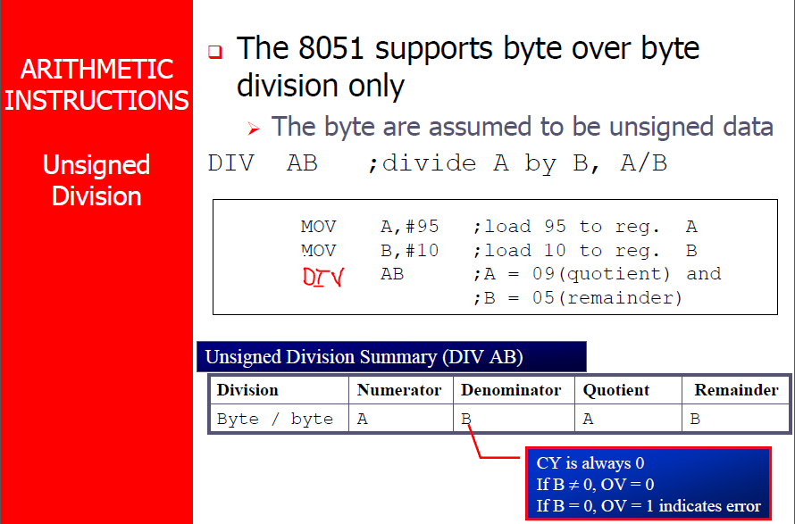

Slide 22
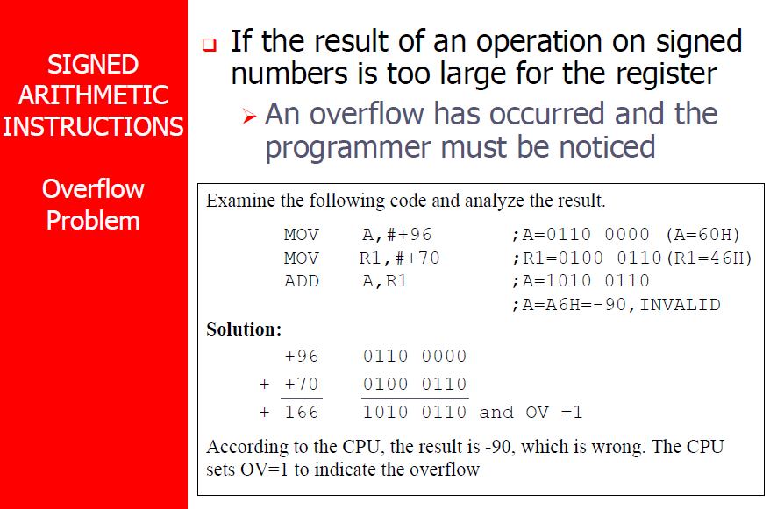

Slide 23
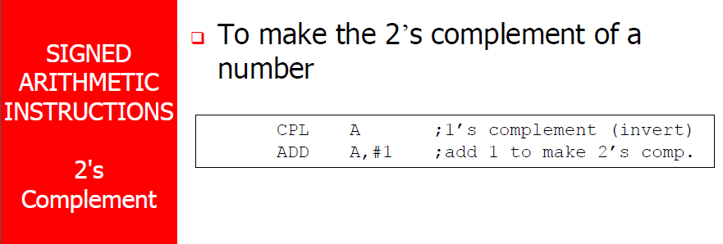

Slide 24
LOGICAL operators

Slide 25
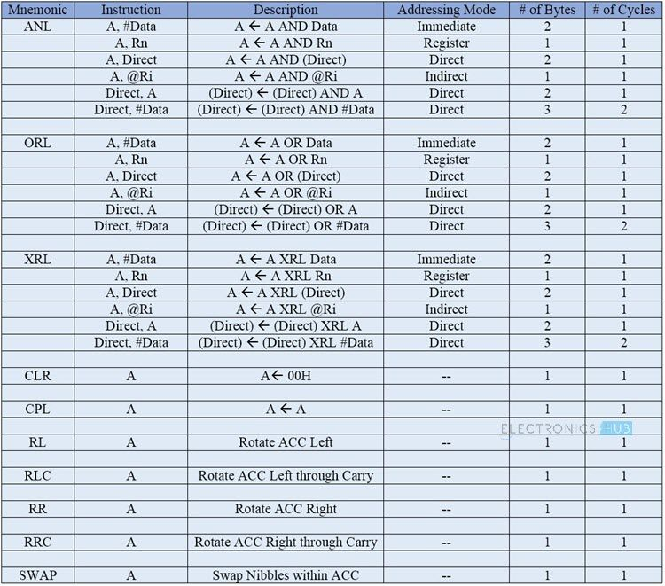

Slide 26
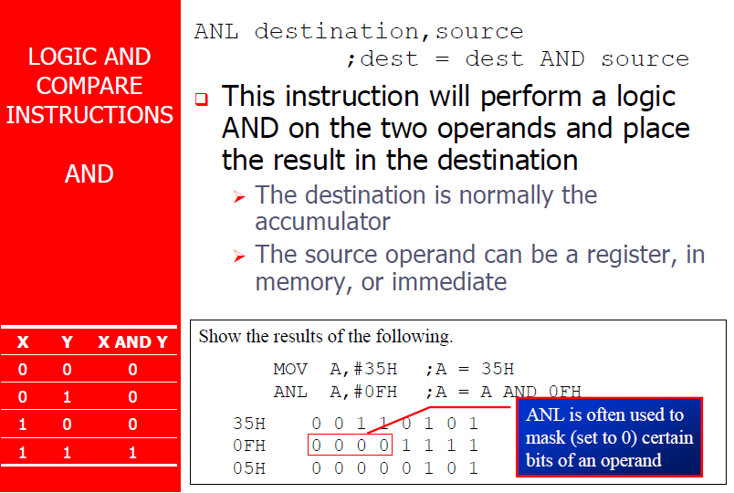

Slide 27
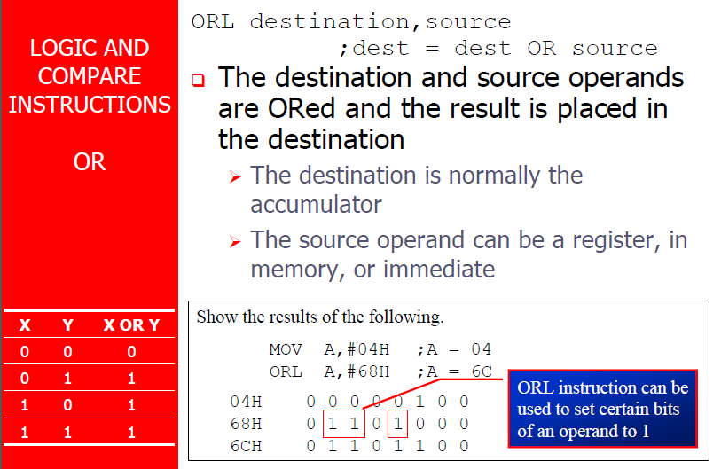

Slide 28
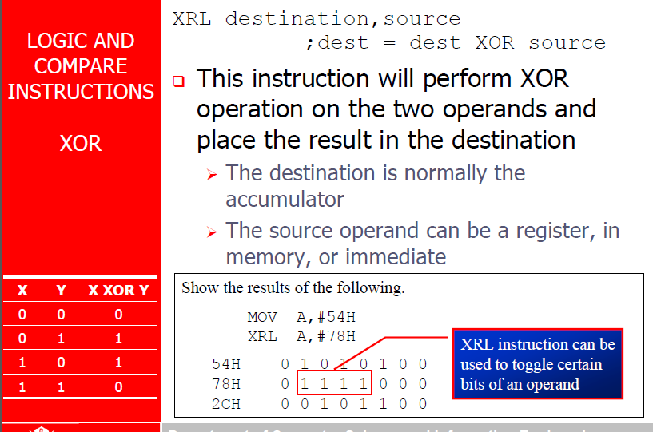

Slide 29
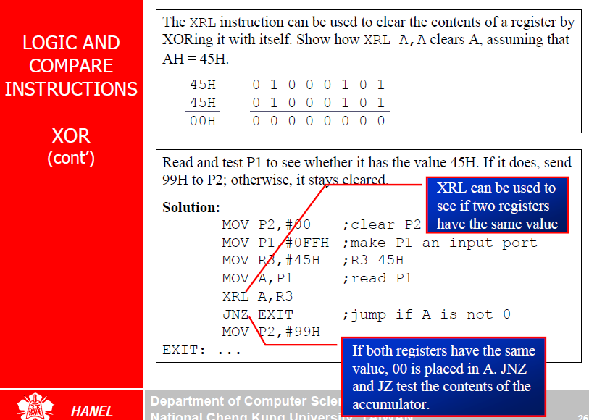

Slide 30
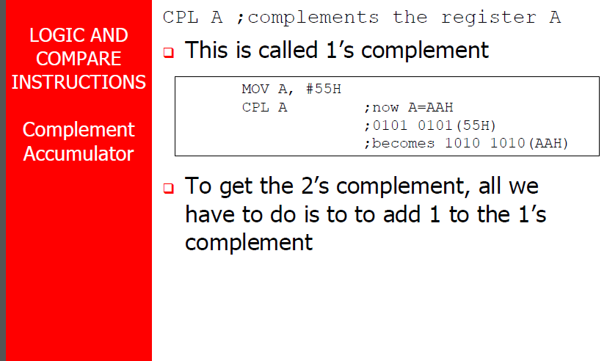

Slide 31
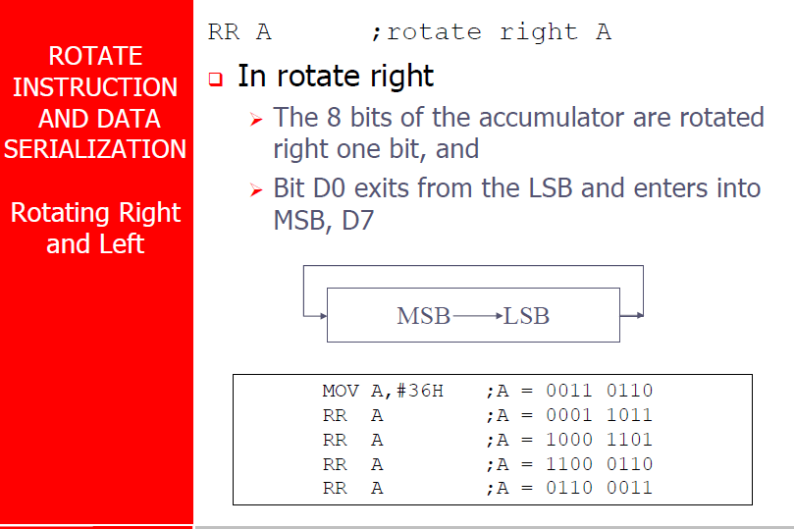

Slide 32
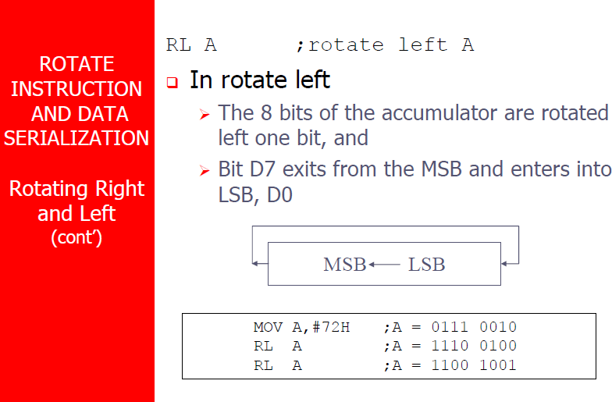

Slide 33
Rotate and Multiplication/Division
Note that a shift left is the same as multiplying by 2, shift right is divide by 2
mov a, #3 ; A← 00000011 (3)
clr C ; C← 0
rlc a ; A← 00000110 (6)
rlc a ; A← 00001100 (12)
rrc a ; A← 00000110 (6)

Slide 34
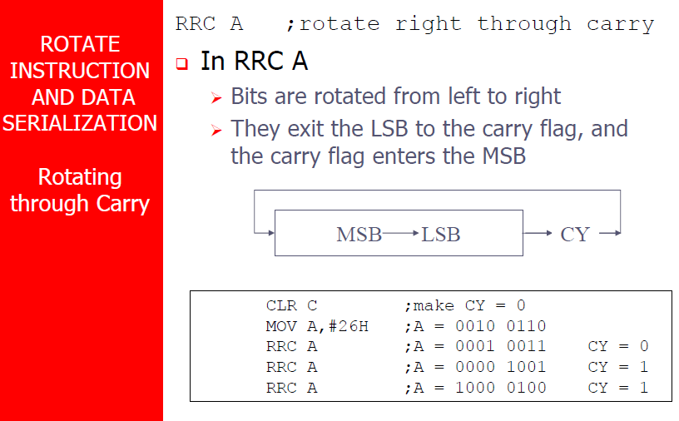

Slide 35
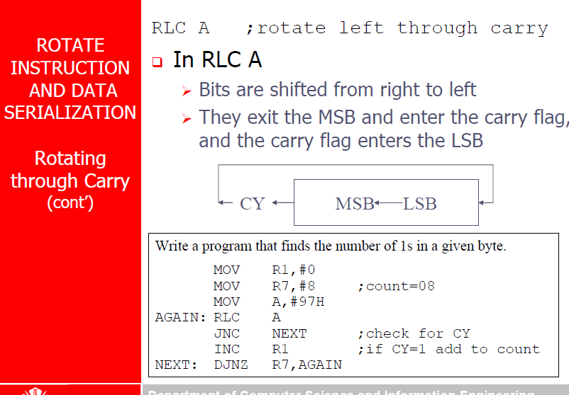

Slide 36
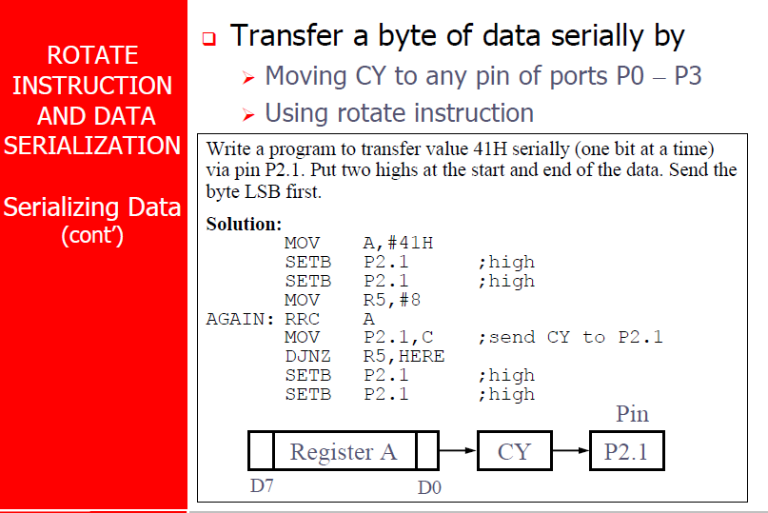

Slide 37
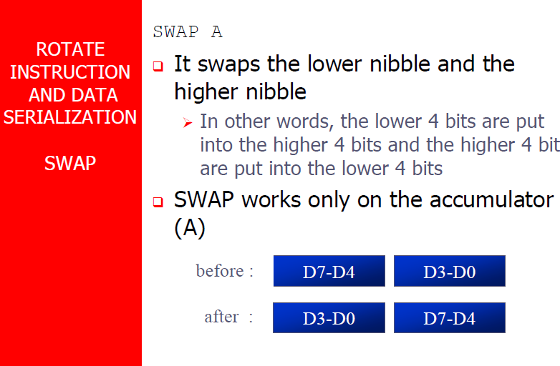

Slide 38
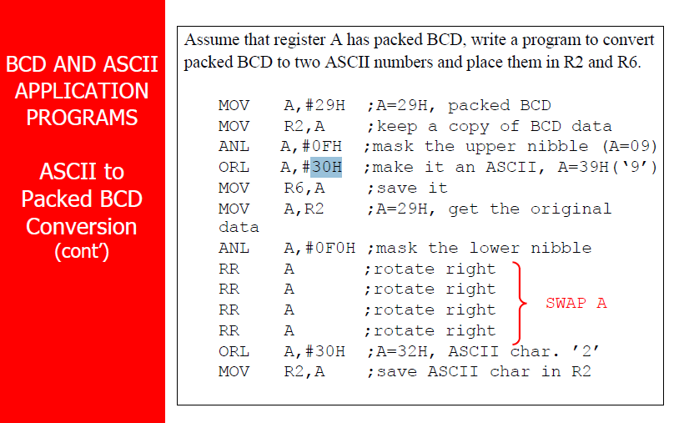

Slide 39
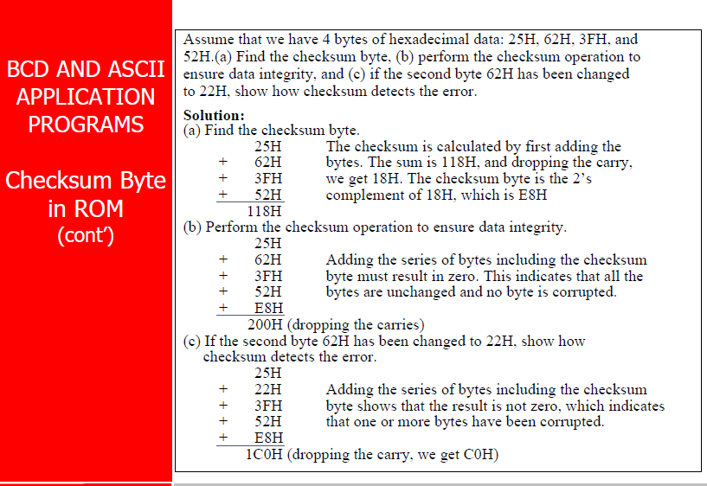

Slide 40
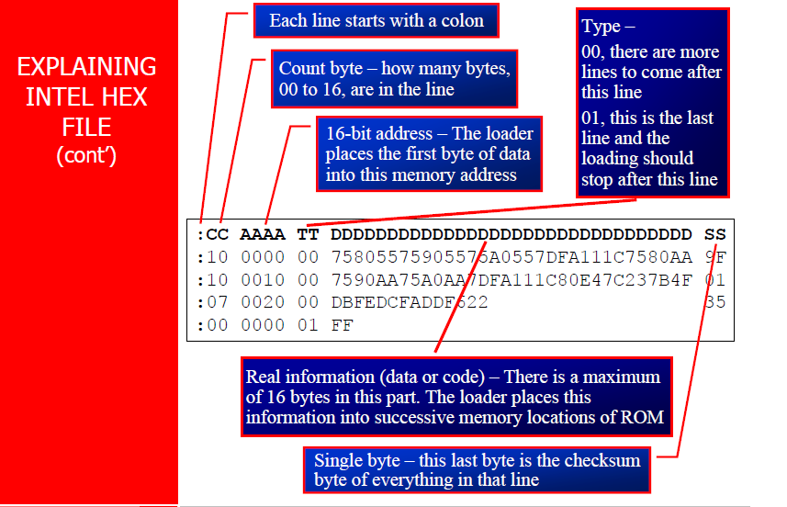

Slide 41
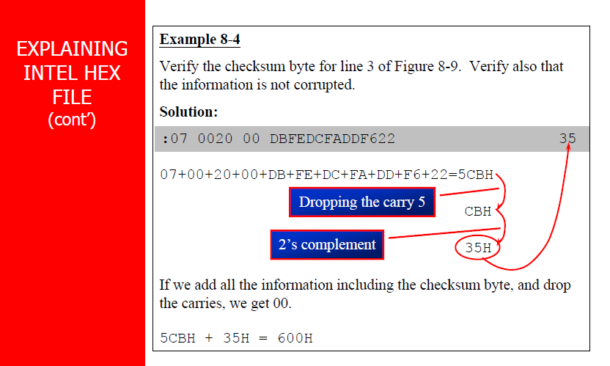

Slide 42
Program Flow Control instructions

Slide 43
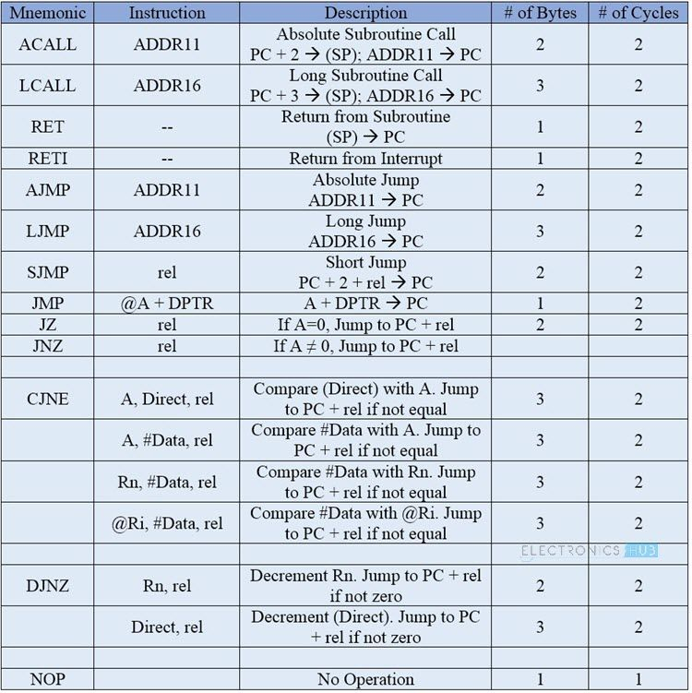

Slide 44
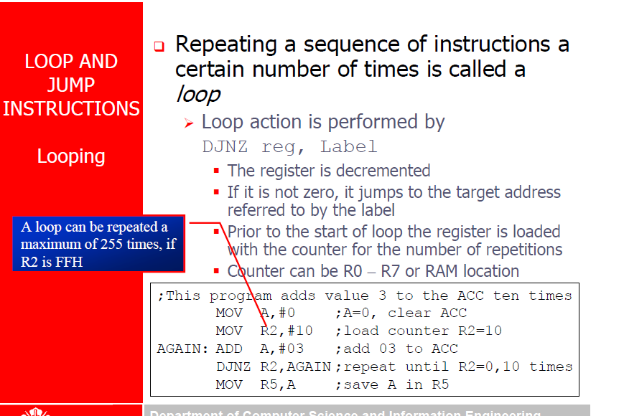

Slide 45
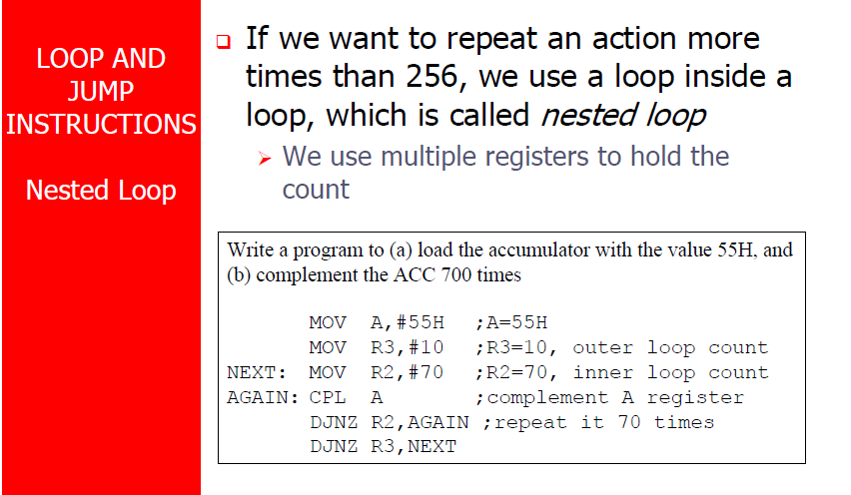

Slide 46
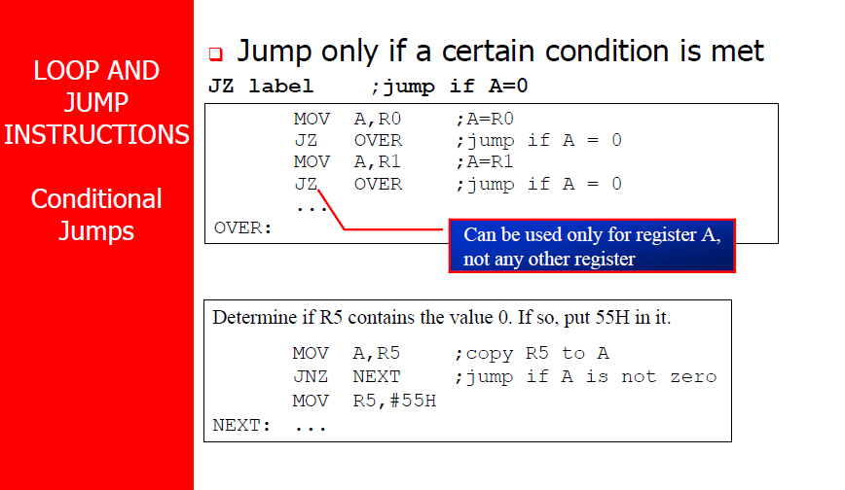

Slide 47
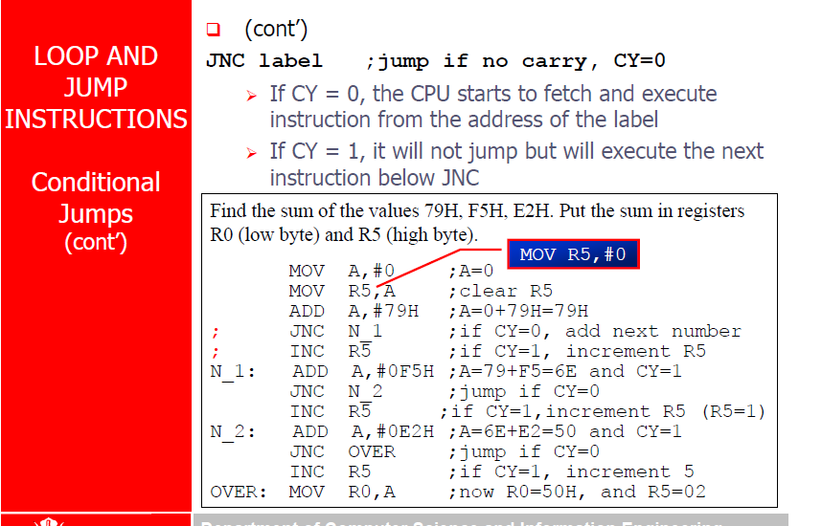

Slide 48
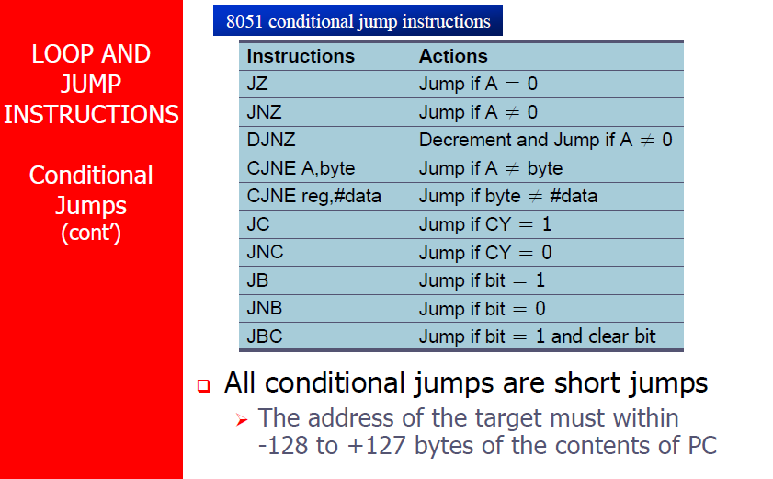

Slide 49
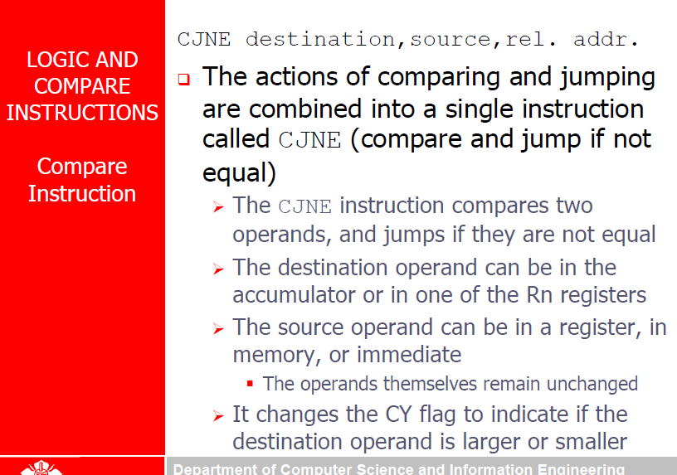

Slide 50
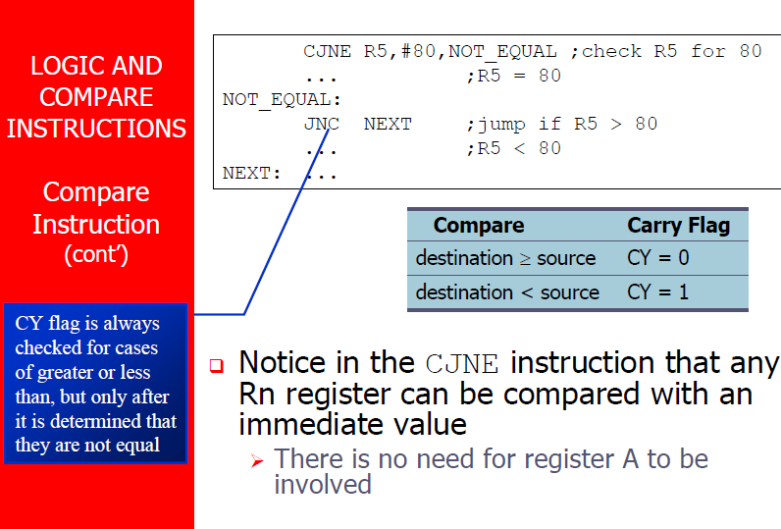

Slide 51
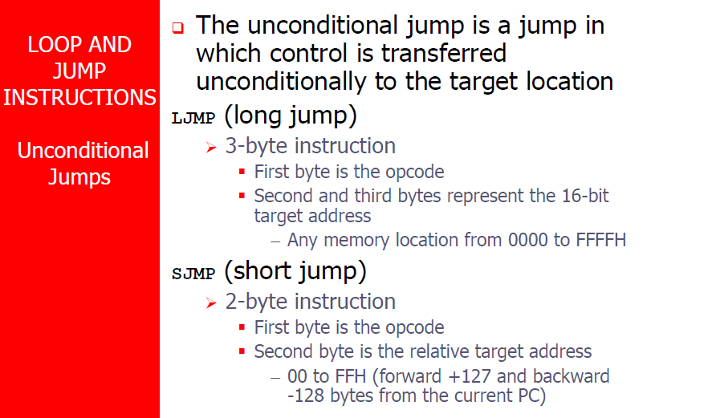

Slide 52
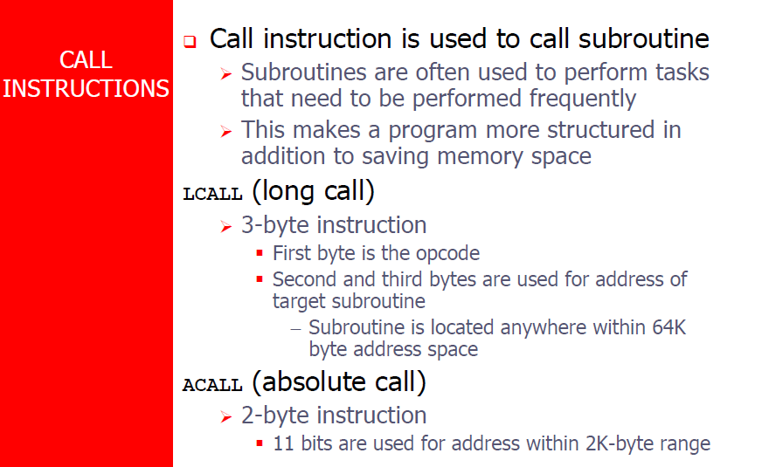

Slide 53
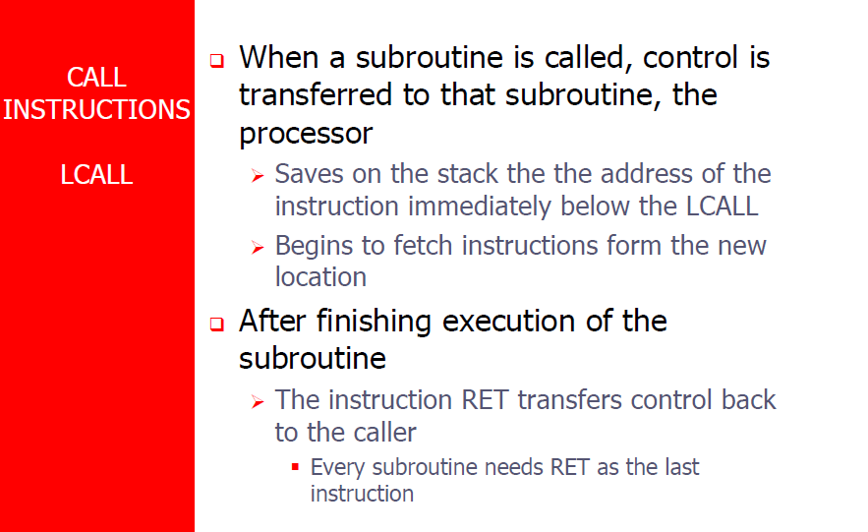

Slide 54
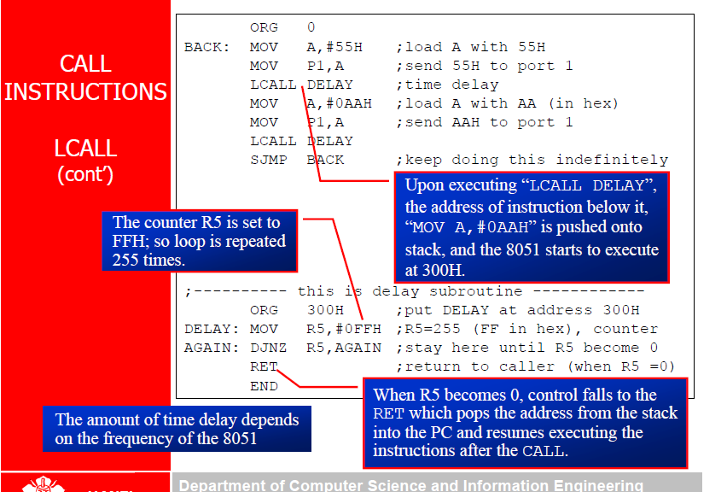

Slide 55
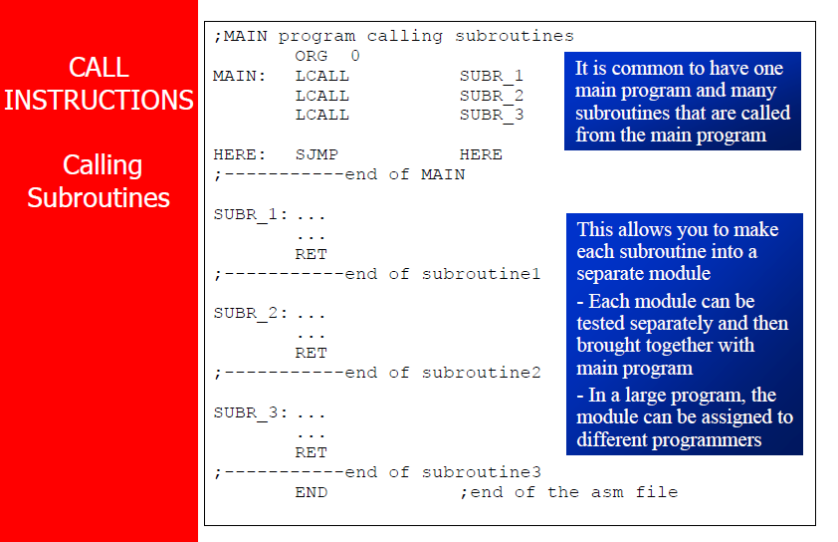

Slide 56
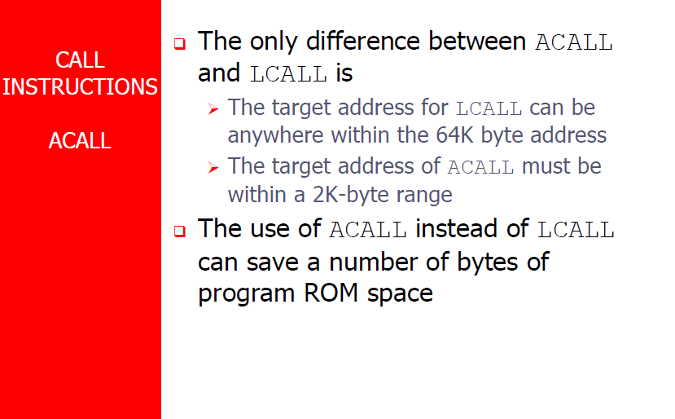

Slide 57
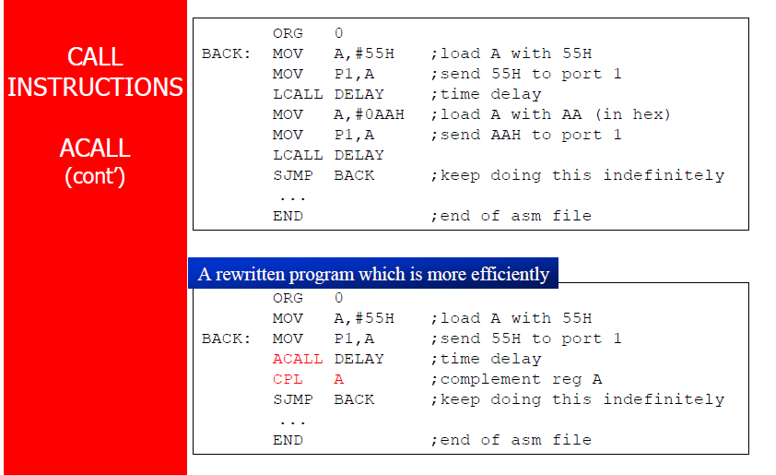

Slide 59
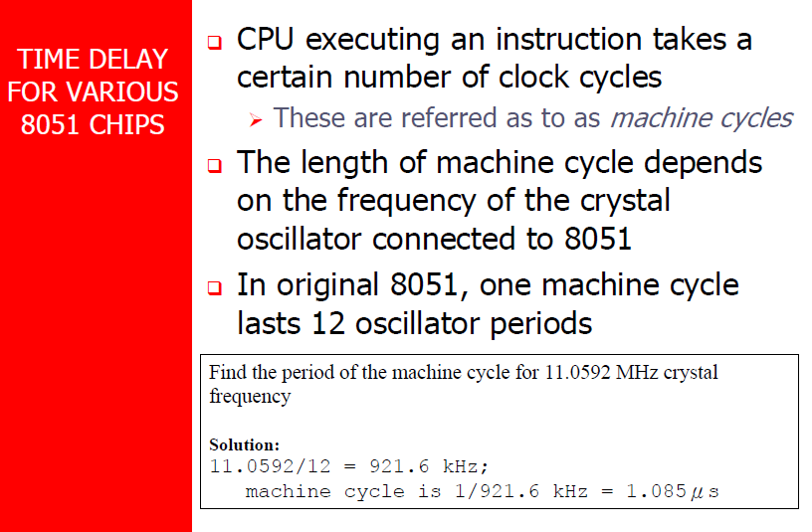

Slide 60


Slide 61


Slide 62


Slide 63


Slide 64


Slide 65


Slide 66


Slide 67


Slide 68


Slide 69


Slide 70


Slide 71


Slide 72


Slide 74


Slide 75


Slide 76


Slide 77


Slide 78


Slide 79


Slide 80


